Slide 1
Citi Bike Data Analysis
Sheng Bi

Slide 2

Citi Bike is the nation's largest bike share program, with 10,000 bikes and 600 stations across Manhattan, Brooklyn, Queens and Jersey City. It was designed for quick trips with convenience in mind, and it’s a fun and affordable way to get around town.

Slide 3
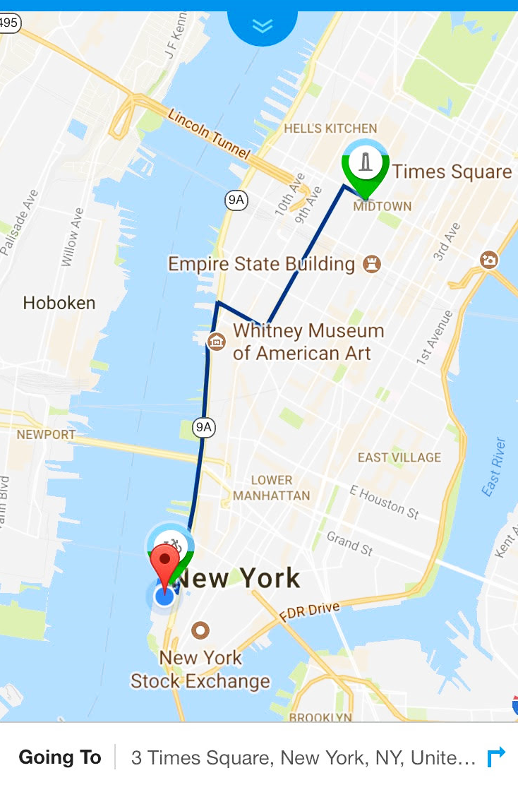

Citi Bike and I
Battery Park City Times Square
~200 Rides
~70 Hours
~496 Miles
~21K Calories

Slide 4
Citi Bike Trip Histories
The data covers from July 2013 to present, including:
Trip Duration (seconds)
Start Time and Date
Stop Time and Date
Start Station Name
End Station Name
Station ID
Station Lat/Long
Bike ID
User Type (Customer = 24-hour pass or 7-day pass user; Subscriber = Annual Member)
Gender (Zero=unknown; 1=male; 2=female)
Year of Birth

Slide 5
In this Project
Visualization: Demographics
Age
Gender
Income
Network Analysis
Subscribers vs Non-Subscribers
Quantitative Models

Slide 6
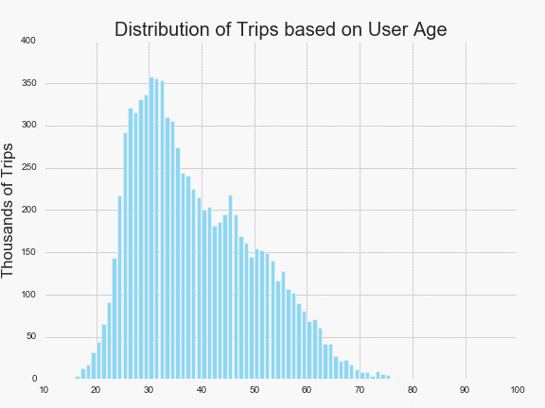
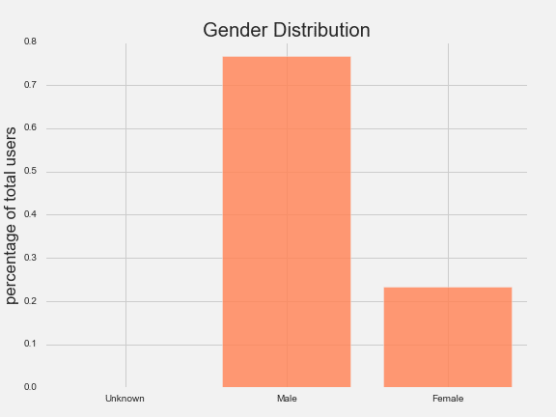
Age: Most Popular around 30
Gender: less attractive to Female

Slide 7
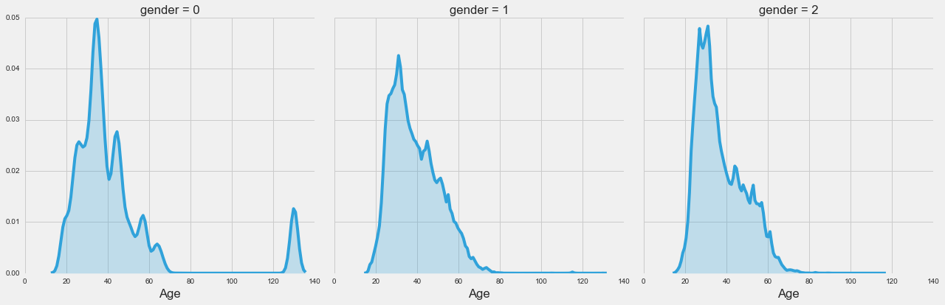
Age vs Gender

Slide 8
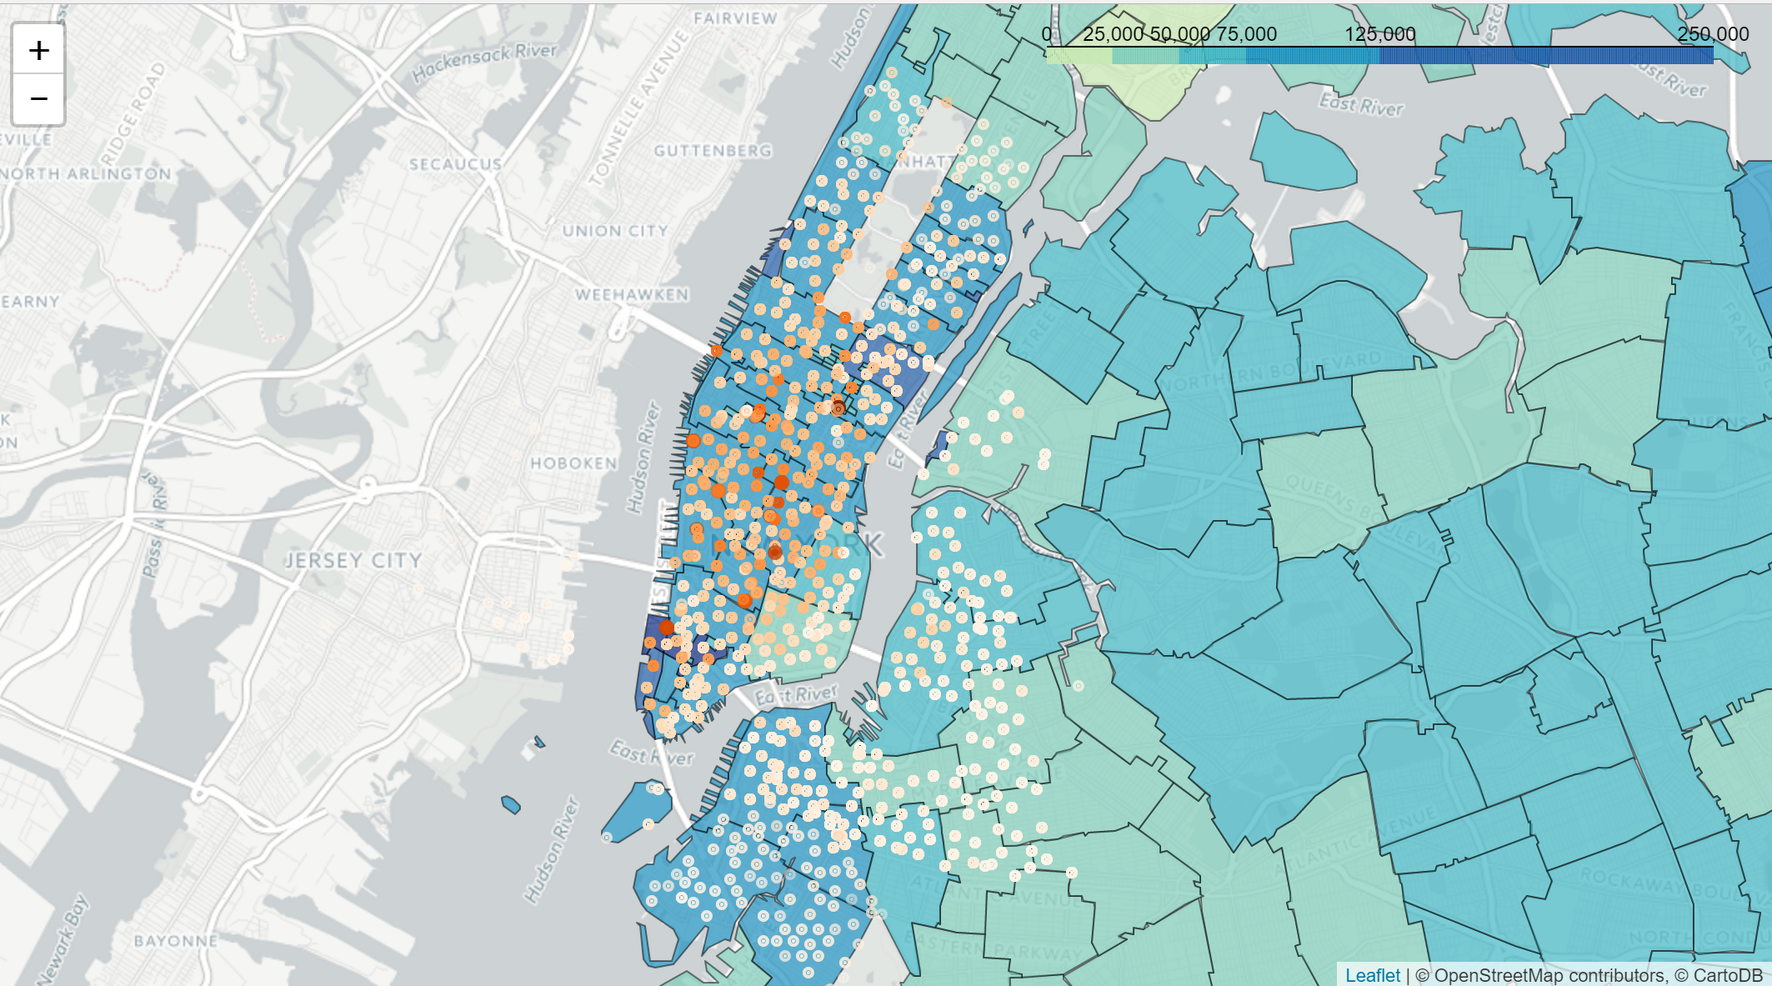
People with higher income ride more?

Slide 9
Network
Graph
Behaviors of Annual Subscribers and Non-Subscribers
NetwokX and Folium
Popular Stations/Routes

Slide 10
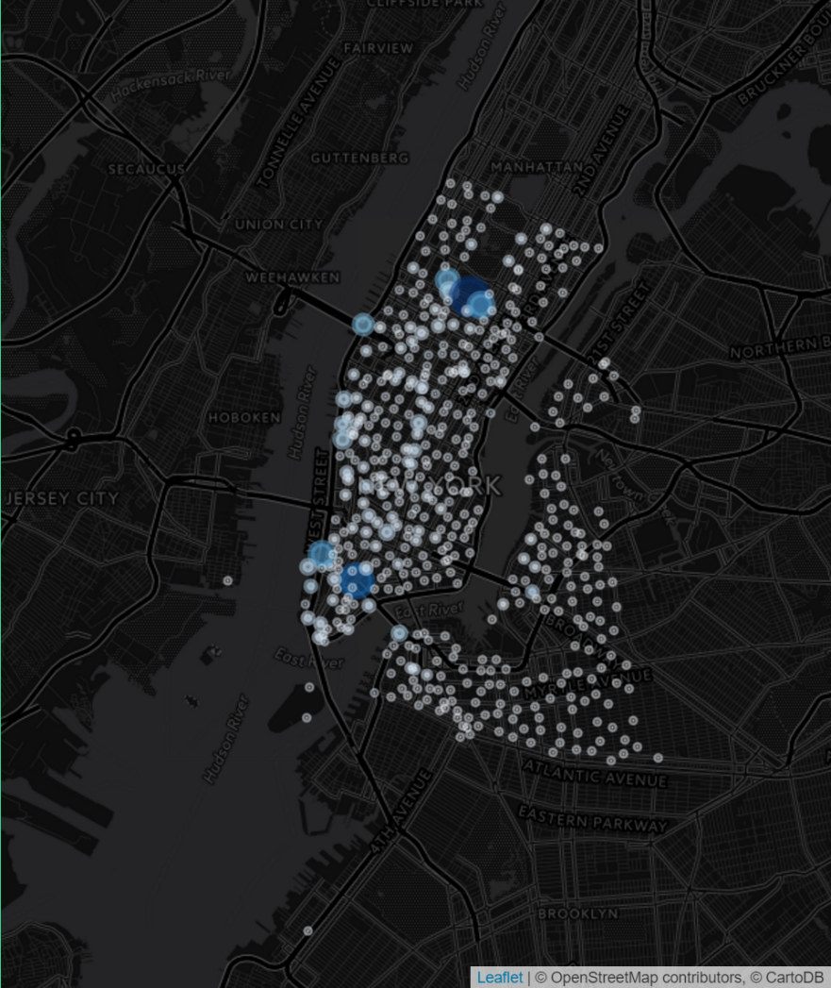
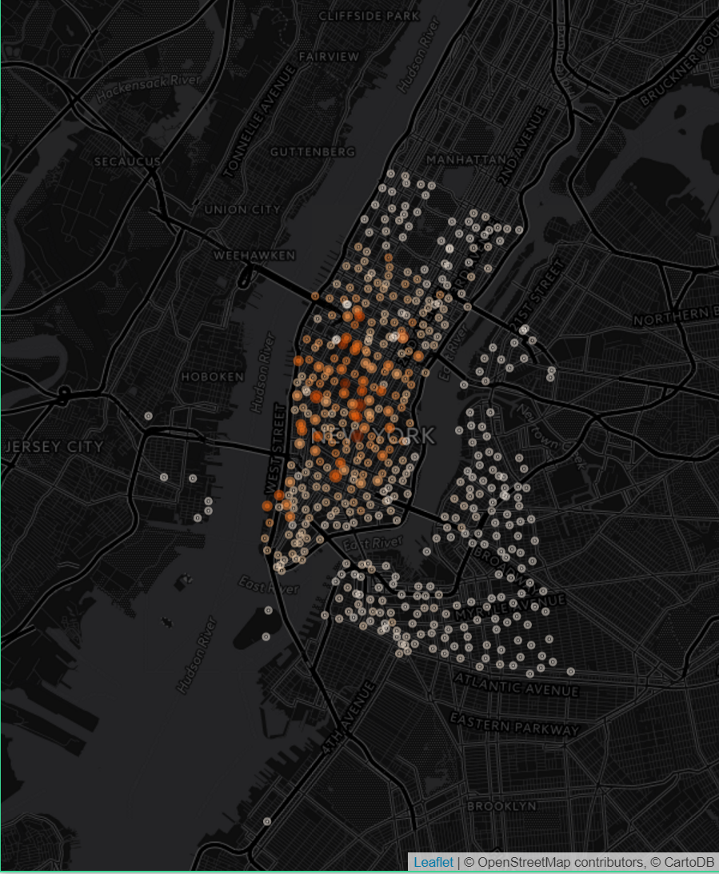
Popular Stations among Non-Subscribers
Popular Stations among Subscribers

Slide 11
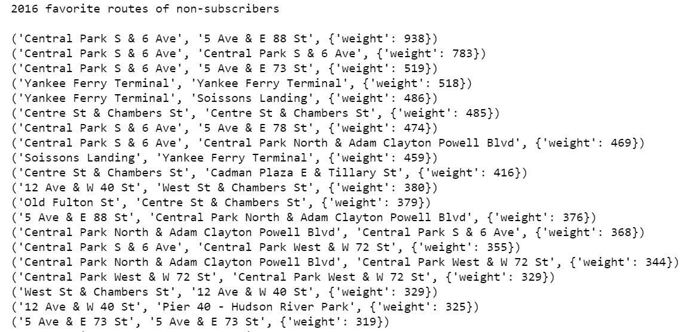
Popular Routes of Non-Subscribers

Slide 12
Quantitative Model
Quantify the Impact of Weather on Bike Activity
Quantify the Impact of Income on Bike Activity
Sklearn
To be continued..

